Slide 1
PCMH: Learning Collaborative Meeting #2
American Academy of Pediatrics – Arkansas Chapter
May 19, 2015

Slide 2
Objectives
Introductions/Overview
Population Management: Dennis Z. Kuo, MD, MHS
Staff Roles/Teams: Dennis Z. Kuo, MD, MHS & Amy Irby, Conway Clinic
SHARE Presentation: Justin Villines
Review of Individual Reports: Dennis Z. Kuo, MD, MHS
Discussions of Individual PCMH Related Concerns/Wrap Up & Q&A: Amber McGuire, Central Arkansas Pediatrics & Dennis Z. Kuo, MD, MHS

Slide 3
Disclosures
Support provided by Arkansas Medicaid

Slide 4
Joining us Today
Arkansas AAP Leadership
Orrin Davis, MD, FAAP- President
Dennis Z. Kuo, MD, MHS- Vice President
Chad Rodgers, MD, FAAP – Secretary
Chris Schluterman, MD, FAAP - Treasurer
Arkansas AAP staff
Aimee Olinghouse, Executive Director
Kristen Pfeifer, QI specialist

Slide 5
Population Management
Dennis Z. Kuo, MD, MHS
May 19, 2015

Slide 6
Objectives
Understand the importance and basic processes of population management
Be able to explain why…and lead others
Notes:
Get past the theory

Slide 7
What is population management?
The health outcomes of a group of individuals
Medical care is only one of many factors that determines health
Public health
Social environment
Etc
But there are so many things we can’t control!

Slide 8
Why do population management?
Better health
Better health outcomes
Lower cost
Higher provider satisfaction
Higher patient satisfaction

Slide 9
Requirements
Registry (IT)
Care coordination
Multidisciplinary care teams
Continuous care
Health behavior and lifestyle changes

Slide 10
New expectations
Regular, proactive contact with patients
Move away from encounter-based care
Move towards care based on needs
Support efforts to manage own health
Work in teams
NOT the same as delegating

Slide 11
Taking steps one at a time
Payments supporting time needed for population management
Data registries
Stratification (prioritize) of patients need
Team-based care / delegation / reorganization
Reactive to proactive management
Adapted from Van Cleave, Pediatrics 2015

Slide 12
Sounds good, but…
….what are the challenges that you have encountered?
….what are the successes that you have achieved thus far?

Slide 13
Population monitoring
Patient registry
Where does the registry data come from?
What is the format of the data?
Who monitors the registry?
Stratification
Sorting methods
Then…what do you do with all of this data?

Slide 14
Question
How do you determine whether a patient needs additional intervention?
Examples
Diagnosis
ED use
Inpatient use
Future appointments

Slide 15
What are the processes you have tried?
Registry development
Registry monitoring
Stratification
Action steps from data
Patient alerts
Etc.

Slide 16
Staff Roles/Teams: Dennis Z. Kuo, MD, MHS & Amy Irby, Conway Clinic

Slide 17
Teams
Dennis Kuo, MD, MHS
May 19, 2015

Slide 18
What is a team?
A team is a small number of people with complementary skills who are committed to a common purpose, set of performance goals, and approach for which they hold themselves mutually accountable.
--Katzenbach and Smith

Slide 19
Characteristics of teams
Share a common purpose
Agree on performance goals
Define a common working approach
Develop high level of complementary skills
Hold themselves accountable for results
Pediatric Leadership Alliance

Slide 20
Why teams in medicine?
Increasing specialization
Patient-centered care
Administration
A high functioning team is more than the sum of its parts
Adapted from McKenna and Pugno

Slide 21
Advantages of a team
Involves more people
Distributes workload
Capitalizes on diverse skills/knowledge
Broadens perspective
Provides development/learning opportunities
Accomplishes more
Pediatric Leadership Alliance

Slide 22
Disadvantages of a team
More difficult to structure
Takes time to develop
Can be high maintenance
Can be inefficient/dysfunctional
Requires greater time/resource commitment
Pediatric Leadership Alliance

Slide 23
Examples of teams
What are teams that you belong to?
What teams might you lead?

Slide 24
Care teams
Not sufficient to just say “Dr. Smith’s patient” because there are so many aspects of population health we are managing
Population review
Identity for patients and families
Physician + nurse = usual minimum

Slide 25
Team tasks
Data review
Huddles
Protected time
Action steps
Processes

Slide 26
Team member requirements
Right mix of skills
Technical or functional expertise
Problem solving and decision-making skills
Interpersonal skills
Skills can be developed
Katzenbach and Smith, “The Discipline of Teams”

Slide 27
Being an effective team player
Prepare
Actively participate
Keep your promises
Keep a positive public persona
Pick your battles
Be honest and diplomatic
McKenna and Pugno; Kennedy MM

Slide 28
Collaboration and teamwork
Engage others to work together
Use language that draws others in
Find common ground for mutual benefit
Conflict management
Beware of pitfalls
Ego trap--”always know best”
Self-promotion
Inattentive listening (exercise)
Insufficient personal interaction
McKenna and Pugno

Slide 29
Building team performance as a team leader
Establish urgency, performance standards, and direction, with compelling context
Select members for skill and skill potential
Pay particular attention to first meetings
Set clear rules of behavior
Set goals
Challenge the group with fresh facts and information
Spend lots of time together
Positive feedback, recognition, and reward
Katzenbach and Smith, “The Discipline of Teams”

Slide 30
Conway Children’s Clinic Staff Roles/Teams May 19, 2015
.

Slide 31
PCMH Executive Committee
Subdivide PCMH patients into disease categories. List providers, location, dates of scheduled visits, and proposed visits.
Make sure all patients have a PCMH flag in Greenway
Request staff scans all correspondence from a specialty clinic received in the last year.
Make sure each patient has an e-mail address in the chart.
Make sure a school and/or daycare is listed in the chart with email address. This is noted in the facesheet under the social history.
Within clinical alerts: document the name of all specialty clinic(s) and doctor(s) and dates of next appointments if available.
On the facesheet, add the appropriate diagnoses to the problem list. Specific details can be added under each diagnosis. I suggest sticking to the main diagnoses (if the provider wants to add subsequent diagnoses let that be their choice, since they are going to be responsible for addressing each problem in their progress note).
Update the medication list.
Institute a mechanism where we can identify future PCMH patients.
Consideration of future PCMH patient categories include GYN/ Depo-Provera, acne, migraine/headache, others?
Current PCMH progress note and H & P templates include mental health, asthma, WCC, and obesity. In correspondence, there is an asthma action plan. In the quick note category here is a template-the asthma control test that can stand-alone or used along with an asthma template. There is also a quick note-mealtime rules for toddlers and children, which can be used as a stand-alone handout or merged with a WCC template and with some additions, can be used for many feeding problems.
Future planned templates include a Down's syndrome quick note that can be merged with a WCC and address age-appropriate plans.
My plans is also to update our WCC templates to include age-appropriate AAP guidelines for lab and developmental screening.

Slide 32
PCMH teams
Dr. Killingsworth: Kerrie/Lee Ann
Dr. Holland: Tammy/Maria
Dr. Michaels: Wendi/Cameria/Madison
Dr. Sutherland: Brooklyn/Jody
Dr. Staley: Randa/Cameria/Kristen
Debbi Wingfield: Chelsea/Melanie
Misty Birdwell: Erika/Tanya
Lisa Martin: Tori/Madison
Kirsten Kravitz: Amanda/Jody

Slide 33
Job description: Front staff
Maintain an up-to-date list of your provider’s PCMH patients. You may customize this list to your specifications.
Keep track of needed appointments. PCMH patients must have a yearly WCC and problem driven encounters at least every 6 months. This my occur more often depending on the severity of the problem or other factors. It is your responsibility to arrange timely appointments while also allowing adequate time for the visits. You should coordinate appointments with your nurse and provider.
Devise a system to notify patients of needed appointments.
Within patients flags, you will document notification of placement in a PCMH. In addition, you will document attempts to schedule appointments, etc.
Make sure all of your patients have a PCMH flag in Greenway.
It is imperative that each patient has an email address within the chart. Explain that this will become a primary way of providing information or corresponding with the family. Once the patient portal is in place, we are going to transition our patients to do more things online especially completing paperwork prior to appointments. We are going to start with our PCMH patients. This should present a small group to “test the waters” of the patient portal.
Please note each patient’s school, grade, and teacher within the social history on the facesheet. Remember to update this information at the beginning of each school year or with any changes. It would also be helpful if you attach a school email or fax number next to the school information. You will also want to note a child’s daycare or childcare arrangements along with an email address, also within the social history.
In the near future, our patient care team (located on the facesheet) will be operational. We are going to list the name of the specialty clinic where each PCMH patient receives care. Also, our clinical alerts will be operational. We will keep track of the most recent PFTs of PCMH asthma patients.
It is your responsibility to scan all correspondence related to the PCMH patient in a timely manner.
Keep the lines of communication open between all your team members and rely on supervisory personnel to help with implementation.
It is our goal to standardize PCMH documentation.

Slide 34
Flowsheet for PCMH

Slide 35
Flowsheet for ADHD

Slide 36
Flowsheet for Asthma

Slide 37
Flowsheet for Obesity

Slide 38
Job description: Nursing staff
Maintain an up-to-date list of your provider’s PCMH patients. You may customize this list to your specifications.
Coordinate appointments with the clerical staff member and your provider. WCC must occur every year and problem based visits must occur at least every 6 months. Some patients will be seen much more frequently based on the severity or complexity of their problems.
The clerical staff member will document each PCMH patient’s email address. This will become the primary way you will correspond with your patient. Identify where the email address is located within the chart so you can access it. An option we are exploring is adding some online screening questionnaires such as psychosocial developmental screens for our younger patients, M-CHAT, and Vanderbilt forms. If this option is implemented the completed screening tools will be located within the EMR, they will be automatically scored and have an associated interpretation and recommendation.
The clerical staff member will also record each patient’s school, grade, teacher, and daycare if applicable within the social history on the facesheet. This will provide an easy way to correspond with these key people. Particularly when relaying asthma action plans or checking on the progress of ADHD patients or providing school notes, etc.
In the near future, our clinical alerts will be operational. This will help us keep track of items such as flu vaccines for asthma patients and PFTs. We will also be using the patient care team under the facesheet. We will list the names of the specialty clinics where each PCMH patient receives care.
One of the nurse’s primary responsibilities is to update the medication list. Please note the name, strength, dosage, and frequency of use. Just the name of a medication is not helpful; when you fail to complete the full RX the incomplete medication must be discontinued before it can be recorded correctly. Do not forget to discontinue medications that have been completed or discontinued and note the reason. An up-to-date medication list is very important when using a template that has prompts for the patient’s medications. Coordinate with your provider.
The provider’s primary responsibility is to maintain an up-to-date problem list. Please work in conjunction with the provider to keep an active problem list.
Keep lines of communication open between all your team members and rely on supervisory personnel to help with implementation.
It is our goal to standardize PCMH documentation. Within PCMH, everything will be done the same way. This allows us to cross over for different people and have all the PCMH guidelines fulfilled correctly.

Slide 39
Job description: Provider
Maintain an up-to-date list of your PCMH patients.
Each PCMH patient must have a yearly WCC and a problem driven appointment at least every 6 months. Of course, many patients may need to be seen more frequently. You should coordinate with your team about the frequency of appointments, length of appointment times, etc. Remember you can combine a WCC visit with a problem-based visit but adequate time and charting is necessary.
Refer to the list of duties for your other team members.
Keep lines of communication open between team members and supervisory staff.
Work in conjunction with your nurse to update the patient’s medication list. Don’t forget to discontinue medication from the list if they are no longer in use and document the reason.
Work in conjunction with other team members to update clinical alerts.
One of your primary responsibilities is to keep an up-to-date active problem list. Remember you must address each active problem within a problem based visit or WCC. Therefore, it is important that you note if a problem is resolved or inactive so you will not be required to address it within the note. Work in conjunction with your nurse. Our expectation is that you will keep an active problem list.
Alert Nikki if you identify a patient that should be included in a future PCMH. Also, alert Nikki if a patient should be removed from a PCMH.
Documentation is important within PCMH. Make sure you address each active problem during a WCC or a problem based visit in particular note that a care plan is created or updated. You must also assess the progress achieved (or not) within each active problem. Nikki will review each of your PCMH patient’s charts after a visit and will return them to you if they need additional documentation.
Current available templates include WCC, mental health version 1 and 2 for both new and follow up, asthma, and obesity. There are asthma action plans, an asthma control test, and mealtime rules for toddlers and children. Future templates include Down’s syndrome, headache/migraine, and acne. We are open to other suggestions, and are considering adding Debbi’s Gyn/Depo patients to PCMH.

Slide 40
Questions?
.

Slide 41
SHARE Presentation: Justin Villines

Slide 42
Review of Individual Reports: Dennis Z. Kuo, MD, MHS

Slide 43
Discussions of Individual PCMH Related Concerns/Wrap Up & Q&A: Amber McGuire, Central Arkansas Pediatrics & Dennis Z. Kuo, MD, MHS

Slide 44
Central AR Pediatric Clinic
Amber McGuire, APRN

Slide 45
Case Management Clinic
Clinic designed for our patients affected with asthma and/or obesity
All appointments are scheduled in well child clinic
Referrals: provider, phone nurse, patient/family
Initial appointments are one hour
F/U appointments are 15-30 minutes

Slide 46
Asthma Clinic
Guidelines adapted from the NHLBI
Patients are followed at least every 6 months
ACT given at check in and caregiver/child completes
Spirometry (ages 5 and up), MDI return demonstration, PFM teaching, and asthma action plan updated at each visit
Allergy test as indicated
ImmunoCAP

Slide 47
Asthma Clinic
Billing
99214 (office visit charge)
99354 (prolonged visit charge)
94010 (spirometry charge)
94060 (bronchodilation charge)
99420 (Administration and interpretation of health risk assessment instrument)

Slide 48
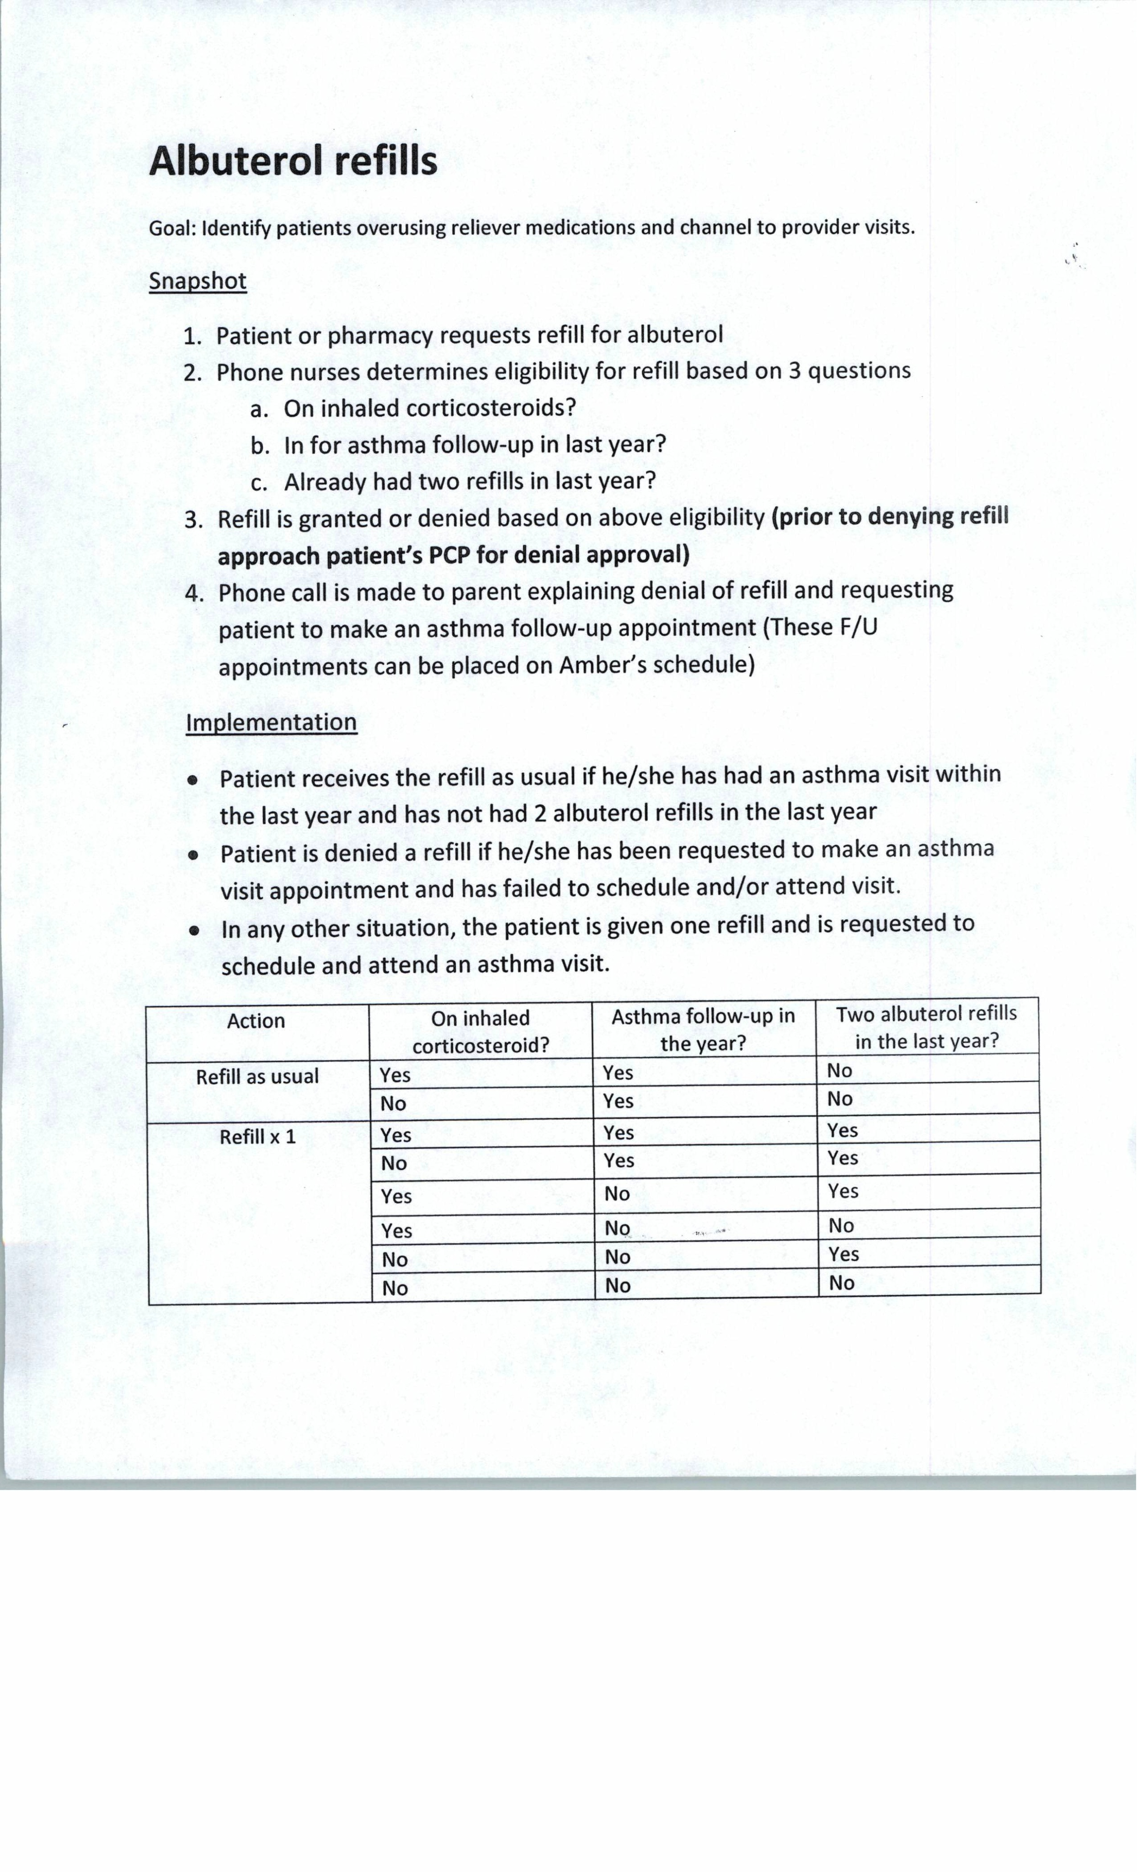

Slide 49
Asthma Clinic
10/1/2013-9/30/2014 Shared savings quality metric:
# beneficiaries with asthma = 144
# with appropriate Rx = 136
% of beneficiaries on appropriate asthma medications: 94%
2014 Quality level: >=70%
2015 Quality level: >=85%

Slide 50
Weight Management Clinic
Providers, families, phone nurses refer any concerning patient with a BMI >=85%
Fasting labs completed prior to appointment
Lab results reviewed with caregiver/patient during initial appointment
All initial patients complete an intake information form given at check in
Assessment and physical
Family medical hx, ROS, assess behavioral risk, complete physical exam
Intervention/prevention counseling
F/U in 1-3 months

Slide 51
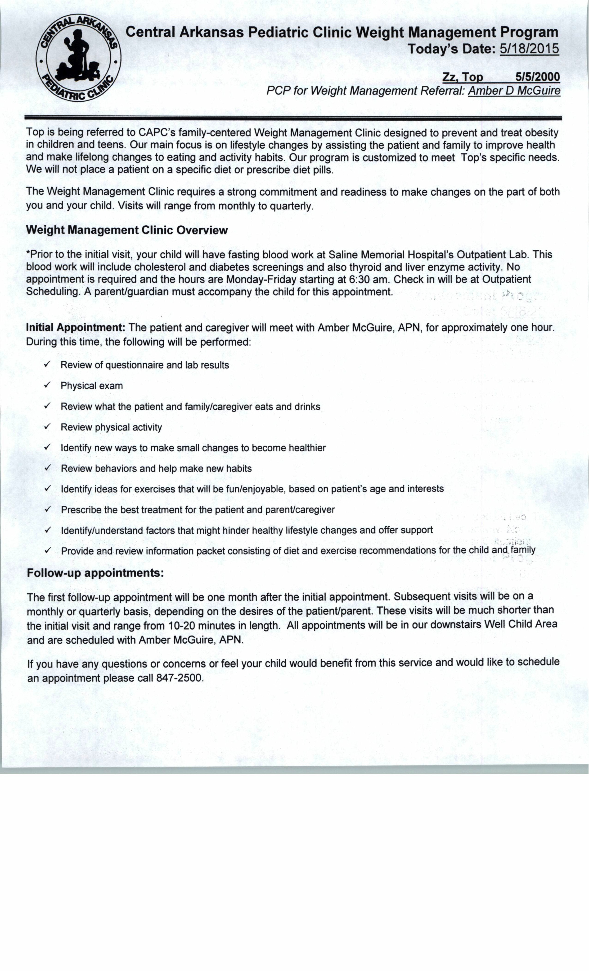

Slide 52
Weight Management Clinic
Billing
99214 (office visit charge)
99354 (prolonged visit charge)
Once BMI <=84% patient enters the maintenance phase
Followed every 6 months or annually
Visits may continue indefinitely

Slide 53
ADHD
After starting a new ADD/ADHD medication patient is seen in one month
Patients are then followed at least every 6 months by PCP/Amber
Weight checks every 3 months

Slide 54
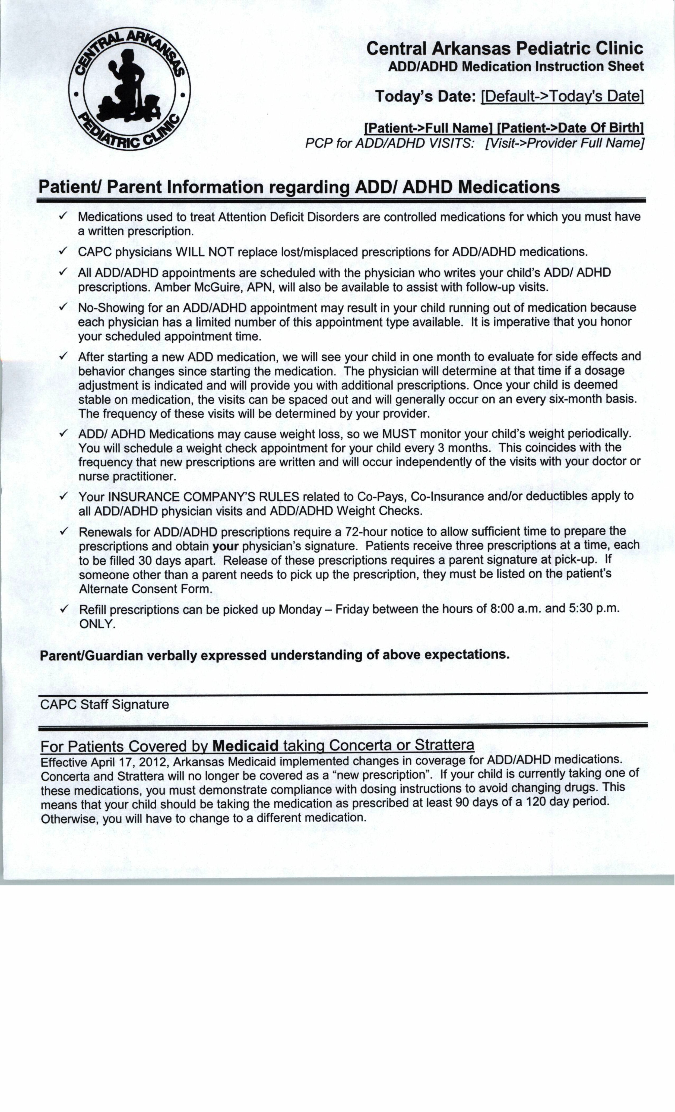

Slide 55
ADHD
10/1/2013-9/30/2014 Shared savings quality metrics:
# with F/U visit within 30 days = 56
# beneficiaries 6-12 with a dispensed ambulatory ADHD Rx = 102
% 6-12 year olds with a F/U visit within 30 days of ADHD prescription initiation = 55%
2014 Quality level >=25%
2015 Quality level >-=50%

